Slide 1

Personal Aviation Authority
Investor Deck — 2026
Private & Confidential

Slide 2

INTERNATIONAL MOTION AUTHORITY
A PLATFORM TO SCALE AN INDUSTRY
TheArsenale Aero will both support growth and rapidly scale with partnerships in related industries.
RIDESHARING
TELECOM
INFRASTRUCTURE
AUTONOMOUS SYSTEM
TA
ENERGY
AIR TRAFFIC SYSTEM
DATA
PERSONAL AVIATION
AUTHORITY
HOSPITALITY
TheArsenale Aero — Investor Deck 2026
Private & Confidential

Slide 3
MARKET SIZE
Air mobility has seen over $10Bn+ investment
Main focus on air taxi, based on Uber Elevate
All five main competitors are pre-revenue and pre-certification — except Volocopter, which is publicly listed
FIVE MAIN COMPETITORS
Joby
PRE-REVENUE
Lilium
PRE-REVENUE
Archer
PRE-REVENUE
Volocopter
PUBLIC
Ehang
PRE-REVENUE
TheArsenale Aero — Investor Deck 2026
Private & Confidential

Slide 4
Urban Air Mobility is projected to be a Highly Profitable & Enormous Market
ANTICIPATED ANNUAL UNIT ECONOMICS PER RIDE-SHARE VEHICLE
$2.4M
Revenue
In order to drive profitability, TheArsenale Aero plans to operate its own fleet of vehicles for urban air mobility.
Direct operating costs will decline over time through scale manufacturing, battery energy density improvements, and autonomy.
Over the life of the aircraft, we believe the Urban Air Mobility business will be 3X more profitable than direct OEM sales.
$1.4M
Direct & Indirect Operating Cost
$1.1M
Operating Income
TheArsenale Aero — Investor Deck 2026
Private & Confidential

Slide 5
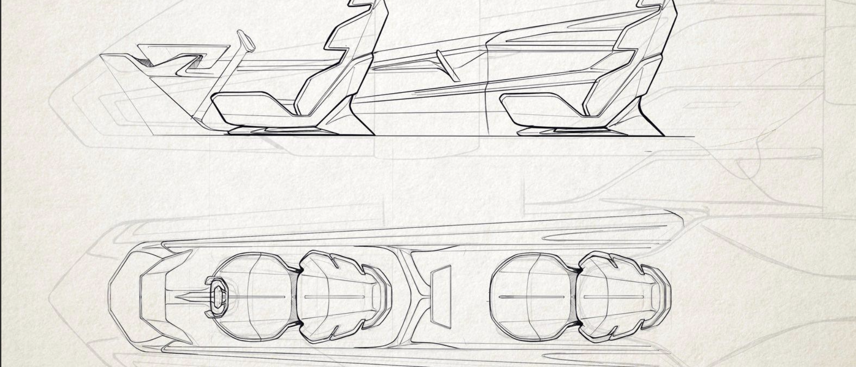
Investing in designing, manufacturing
and testing in-house.
TheArsenale Aero — Investor Deck 2026
Private & Confidential

Slide 6
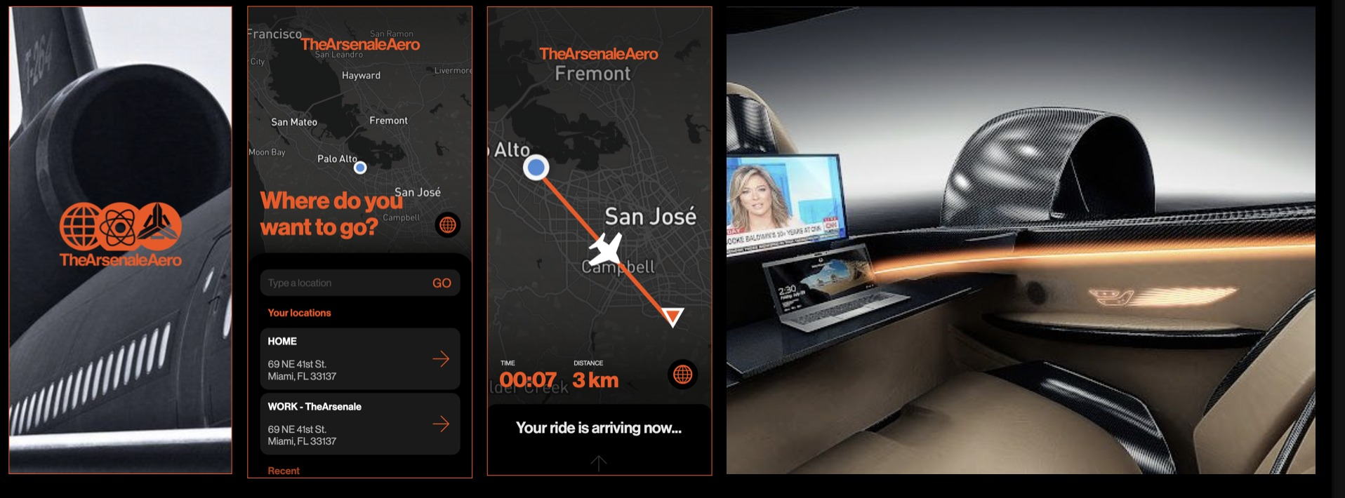
Press a button. Get a flight.
TheArsenale Aero — Investor Deck 2026
Private & Confidential

